Slide 1

Problem Statement
Problem Statement Title: Price comparison of products in major e-marketplaces
Team Name: One piece
Team Leader Name: Saai Krahaanth S JA
College Code : 4116
Institute Name: Prince Dr K Vasudevan College Of Engineering and Technology
Theme Name: Empowering Informed Choices: Comparing Product Prices Across E-Marketplaces

Slide 2
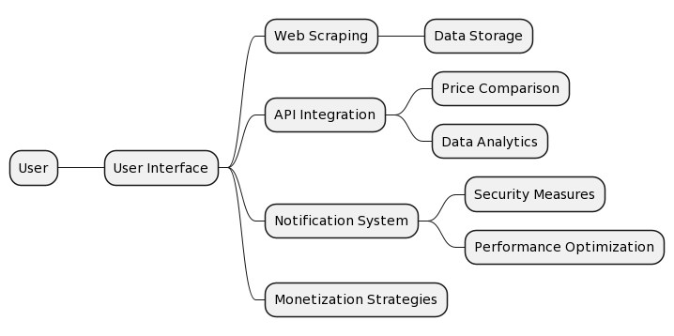
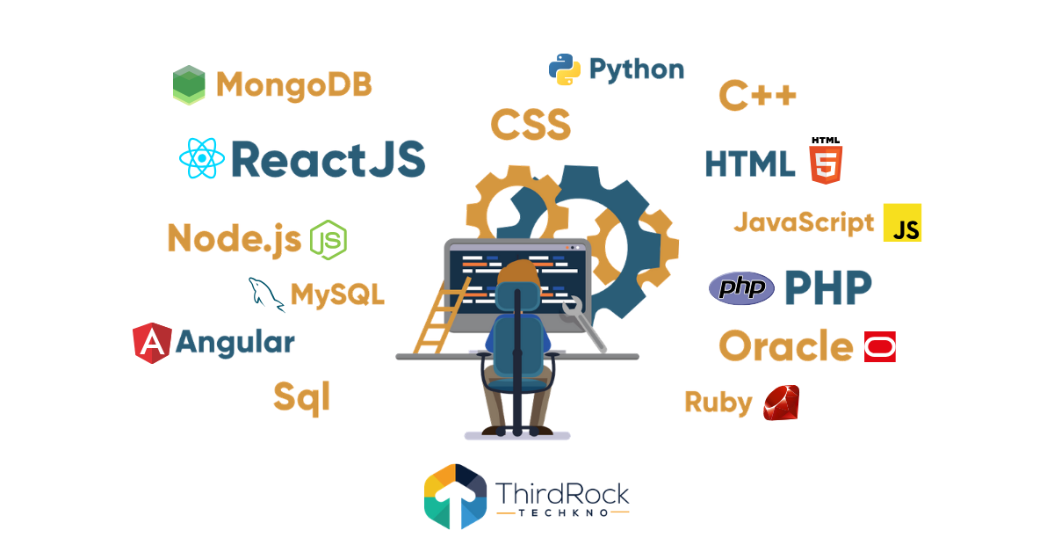
Idea/Approach Details
Our Project will be a web-based platform that enables users to compare prices of products available on various other prominent e-marketplaces, ensuring cost-effectiveness government procurement.
This tool will empower government departments, organizations, and public sector undertakings to make data-driven decisions.
Develop web scraping scripts to extract product data from GeM and other e-marketplaces . Consider using Python libraries like Beautiful Soup and Selenium.
Create a database (e.g., MySQL, MongoDB) to store the collected data, ensuring it is well-organized and accessible for analysis.
Implement dynamic and statistical algorithms that compare product prices, taking into account various factors, such as shipping costs, discounts, and taxes.
Allow users to set price drop alerts for products they are interested in.
Send notifications via email or push notifications when significant price changes occur.
Explore monetization options such as advertising partnerships, premium features, or affiliate marketing with e-marketplaces.

Slide 3
Idea/Approach Details
Use Cases of Our Project:
Customer Procurement Optimization:
Customers can compare product prices with other e-marketplaces to ensure they obtain the best prices for goods and services.
Small Business Cost Savings:
Small businesses can use Price Wise to find cost-effective suppliers for their procurement needs.
Consumer Shopping:
Everyday consumers can use the platform to find the best deals on products, potentially saving money on their purchases.
Bulk Purchase Planning:
Organizations planning bulk purchases can use the historical price trends to time their procurement for maximum savings.
Price Alerting for Specific Products:
Users can set up price drop alerts for products they intend to purchase, ensuring they don't miss out on discounts.
Vendor Price Comparison:
Vendors can monitor their competitors' prices and adjust their offerings to stay competitive.
Dependencies & Stakeholders:
Data Sources:
APIs of widely used e-marketplaces.
Database Management:
Database system for storing and managing product data.
User Interaction:
Front-end development for user interface, back-end development for functionality.
Security:
Security protocols and encryption to protect user data.
Testing:
Testing tools and quality assurance procedures.
Monetization Partners:
Partnerships for revenue generation.
Infrastructure:
Cloud-based infrastructure for scalability.
Users:
Primary stakeholders, including government departments and organizations.

Slide 4
Team Member Details
Team Leader Name: SAAI KRAHAANTH S JA ( Branch : B.E Stream : CSE Year : III )
Team Member 1 Name: MOHITH SHAKTHI T ( Branch : B.E Stream : CSE Year : III )
Team Member 2 Name: KISHORE P ( Branch : B.E Stream : CSE Year : III )
Team Member 3 Name: KRISHNA RAJ ( Branch : B.E Stream : CSE Year : III )
Team Member 4 Name: KALEESHWARAN A ( Branch : B.E Stream : CSE Year : III )
Team Member 5 Name: MOHANARANGAN ( Branch : B.E Stream : Cse Year : III )

